Slide 1
TAHOE REGIONAL PLANNING AGENCY
Lake Tahoe
Regional Plan
Status Report

Slide 2
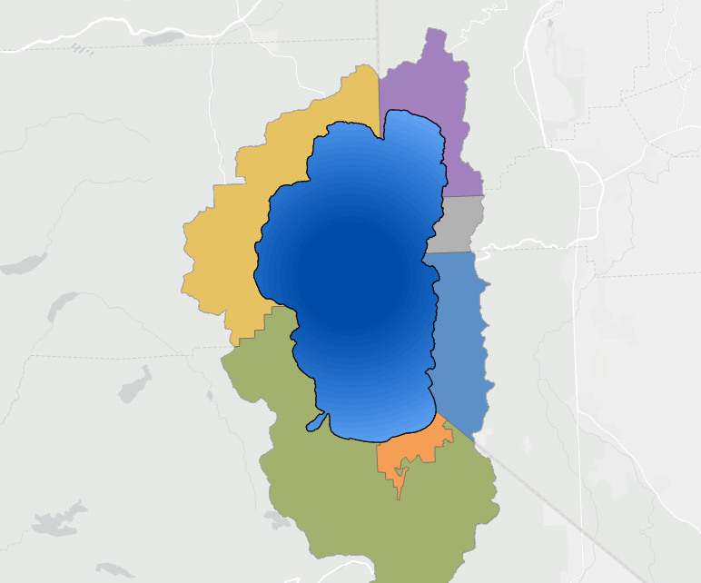
Residential Units
LAKE TAHOE REGION: RESIDENTIAL UNITS BY JURISDICTION
CALIFORNIA
NEVADA
WASHOE COUNTY
PLACER COUNTY
7,958
RESIDENTIAL UNITS
2025
11,818
RESIDENTIAL UNITS
Percentage of Residential Units
CARSON CITY COUNTY
4
RESIDENTIAL UNITS
LAKE TAHOE
EL DORADO COUNTY
DOUGLAS COUNTY
9,105
RESIDENTIAL UNITS
4,719
RESIDENTIAL UNITS
CITY OF SOUTH LAKE TAHOE
15,415
RESIDENTIAL UNITS
Source: Tahoe Regional Planning Agency (TRPA) · Lake Tahoe Regional Plan · 2026

Slide 3
Residential Units — Key Statistics
49,019
+1,469
+113
Total Residential Units (2025)
Net Growth 2012–2025
Avg Annual Net Additions
2012 baseline: 47,550
+3.1% over 13 years
units per year
+1,573
−110
+207
Total Additions
Total Deductions
Peak Year Growth
2013–2025
2013–2025
2025
Key Findings
Approximately 86% of residential development was built before the 1987 Regional Plan
Residential Allocations remain the largest cumulative source (887 units added, 56% of total additions)
Bonus Units surged in 2024–2025, becoming the #1 source of 2024 and 2025 additions
81% of units added since 2012 are on the south shore; 83% in California
Source: Tahoe Regional Planning Agency (TRPA), 2026 Cumulative Accounting

Slide 4
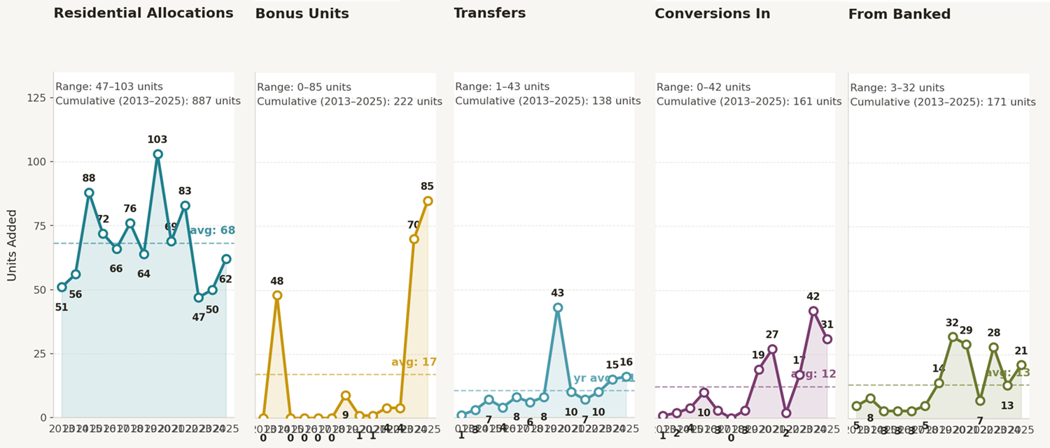
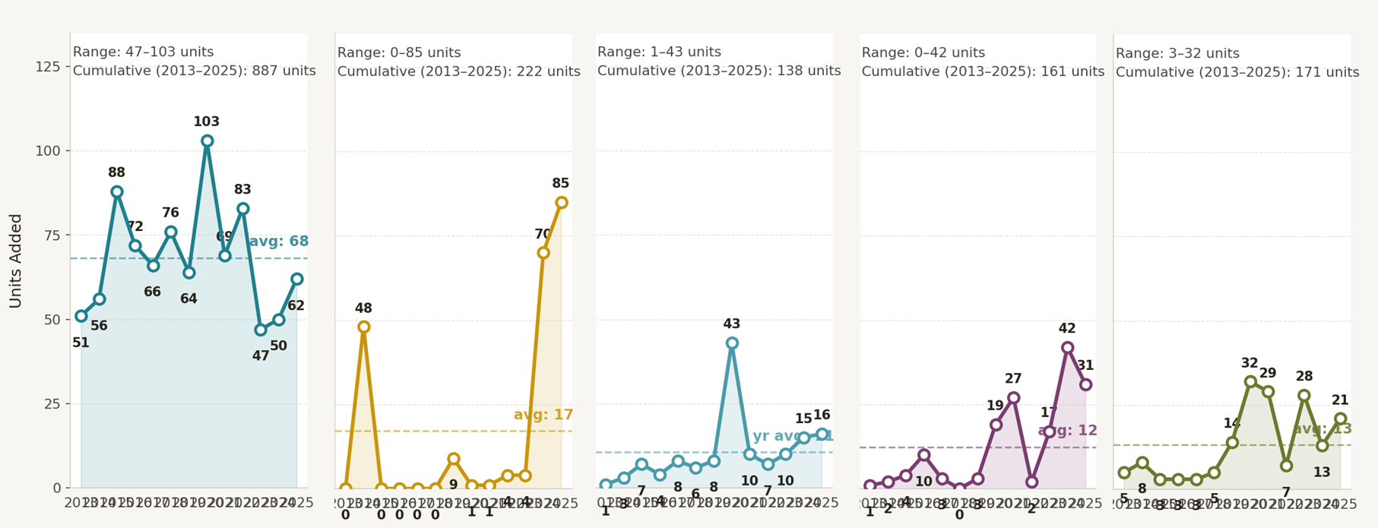
The Composition of Additional Residential Development
More units constructed with bonus units than allocations in 2024 and 2025
Conversions and transfers steadily growing - account for 26% of constructed units
Source: Tahoe Regional Planning Agency (TRPA), 2026 Cumulative Accounting

Slide 5
Residential Allocations Remaining
LAKE TAHOE REGION: UNUSED RESIDENTIAL ALLOCATIONS BY JURISDICTION
CALIFORNIA
NEVADA
WASHOE COUNTY
PLACER COUNTY
135
RESIDENTIAL ALLOCATIONS
349
RESIDENTIAL ALLOCATIONS
As of 2025
CARSON CITY COUNTY
TRPA POOL
0
RESIDENTIAL ALLOCATIONS
154
RESIDENTIAL ALLOCATIONS
EL DORADO COUNTY
DOUGLAS COUNTY
98
RESIDENTIAL ALLOCATIONS
93
RESIDENTIAL ALLOCATIONS
9%
18%
10%
34%
13%
15%
CITY OF SOUTH LAKE TAHOE
UNRELEASED ALLOCATIONS
186
RESIDENTIAL ALLOCATIONS
770
RESIDENTIAL ALLOCATIONS
Source: Tahoe Regional Planning Agency (TRPA) · Lake Tahoe Regional Plan · 2026
Notes:
1,015 Allocations that have not been assigned and 770 allocations held by TRPA that will be released at 130/yr through 2032. Another 175 allocations assigned not built.
Separate pool of Residential Bonus units for income-restricted housing. 741 Bonus Units not assigned; another 523 assigned not built.

Slide 6
Tourist Units — Key Statistics
10,761
-419
-32
Total Tourist Units (2025)
Net Change 2012–2025
Avg Annual Net Change
2012 baseline: 11,180
-3.7% over 13 years
units per year
+211
−630
+154
Total Additions
Total Deductions
Peak Year Growth
2013–2025
2013–2025
2017
Key Findings
Added units at Edgewood and Zalanta offset by large scale removals: Knights Inn, Lakeside Inn, Motel 6, Sunray Motel
66 Tourist Units have been removed and converted to other types of development
Source: Tahoe Regional Planning Agency (TRPA), 2026 Cumulative Accounting

Slide 7
Commercial Floor Area — Key Statistics
6,583,769
+1,850
+142
Total Commercial Floor Area (2025)
Net Change 2012–2025
Avg Annual Net Change
2012 baseline: 6,592,644
+0.0% over 13 years
Square feet per year
+185K
−183K
+48K
Total Additions
Total Deductions
Peak Year Growth
2013–2025
2013–2025
2018
Key Findings
Added commercial at Bijou Marketplace and Chateau offset by large scale removals: Lakeside Inn, Tahoe City Lodge
16K square feet of commercial floor area have been removed and converted to other types of development
Source: Tahoe Regional Planning Agency (TRPA), 2026 Cumulative Accounting

Slide 8
Regional Plan Additional Development Overview
Regional Plan Maximum Additional Development
Residential
Allocations
Residential Bonus
Units
Tourist Bonus
Units
Commercial Floor Area
8,687
2,000
400
1,000,000
Units
Units
Units
Square Feet
Constructed as of 2025
78%
37%
15%
46%
Constructed
Residential Allocations
Constructed
Residential Bonus Units
Constructed
Tourist Bonus Units
Constructed
Commercial Floor Area
6,731 of 8,687 units
736 of 2,000 units
58 of 400 units
464K of 1.0M sq ft
Source: Tahoe Regional Planning Agency (TRPA) · Lake Tahoe Regional Plan, 2026 Cumulative Accounting

Slide 9
Regional Plan Additional Development
Residential Allocations
Max: 8,687 units
Residential Bonus Units
Max: 2,000 units
Tourist Bonus Units
Max: 400 units
Commercial Floor Area
Max: 1.00M sq ft
Source: Tahoe Regional Planning Agency (TRPA) · Lake Tahoe Regional Plan, 2026 Cumulative Accounting
Notes:
Remaining (Assigned Not Built) and Not Assigned:
Residential Allocations = 22%
Residential Bonus Units = 63%
Tourist Bonus Units = 86%
Commercial Floor Area = 54%

Slide 10
Total Development Capacity
Residential Units
Tourist Accommodation Units
Commercial Floor Area
Existing 2025
Banked
Remaining Regional Plan
Source: Tahoe Regional Planning Agency (TRPA) · Lake Tahoe Regional Plan, 2026 Cumulative Accounting
Notes:
86% of the existing residential development today (~42K units) was built before the 1987 Regional Plan.
93% of the existing commercial floor area today was built before the 1987 Regional Plan.

